Slide 1
Wordpress
And how to use it

Slide 2
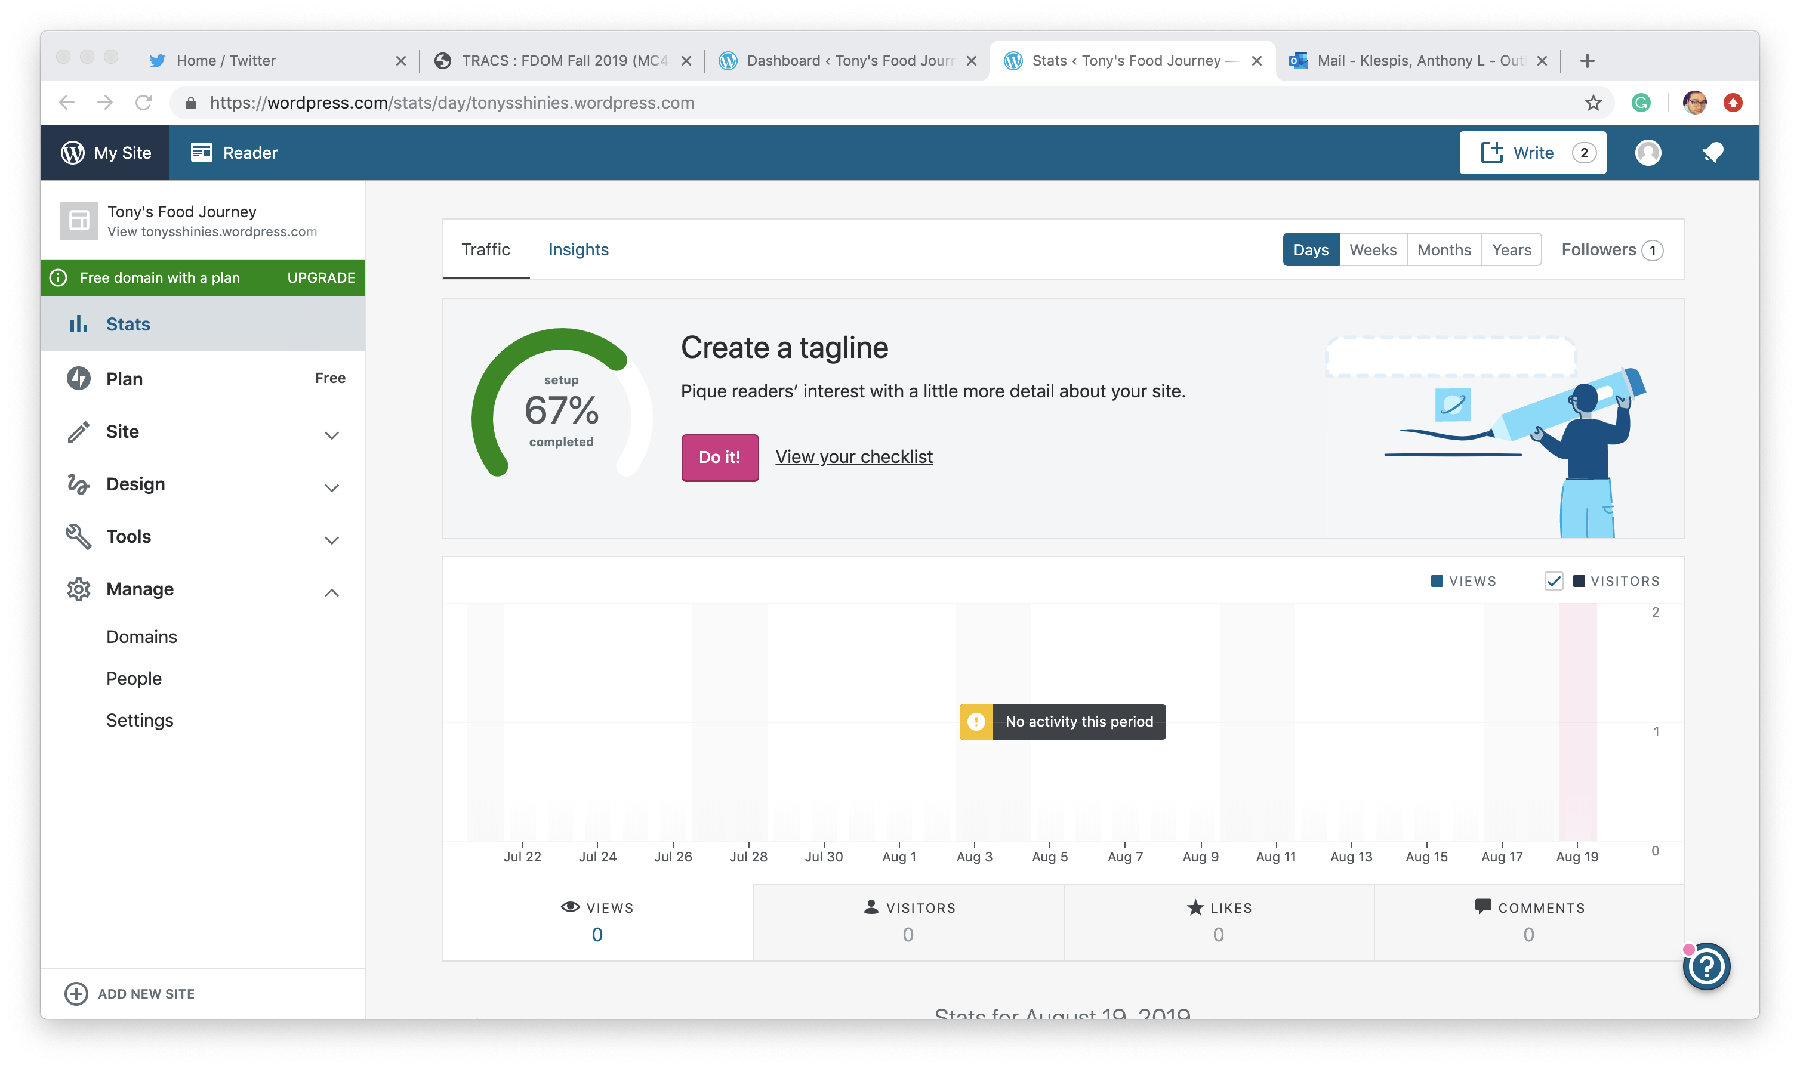
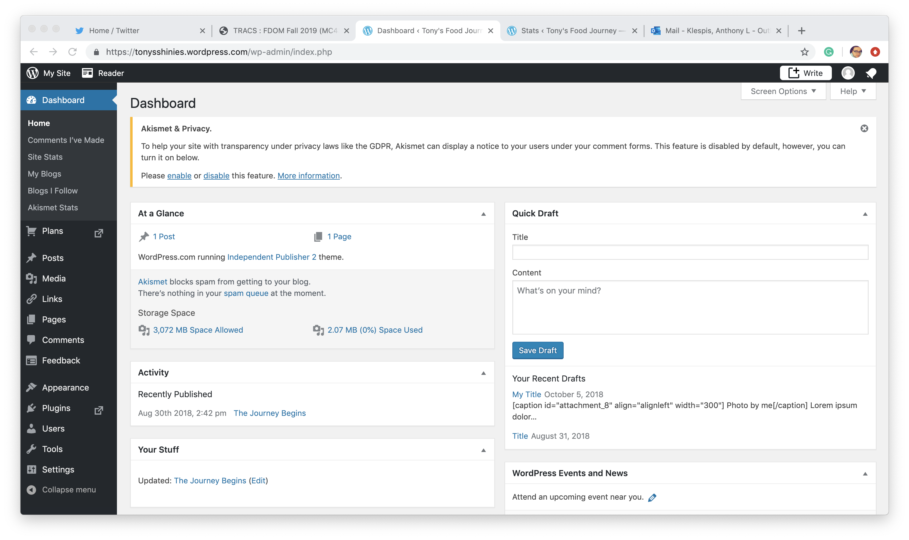
Accessing the dashboard
Basic dashboard
Wp-admin dashboard

Slide 3
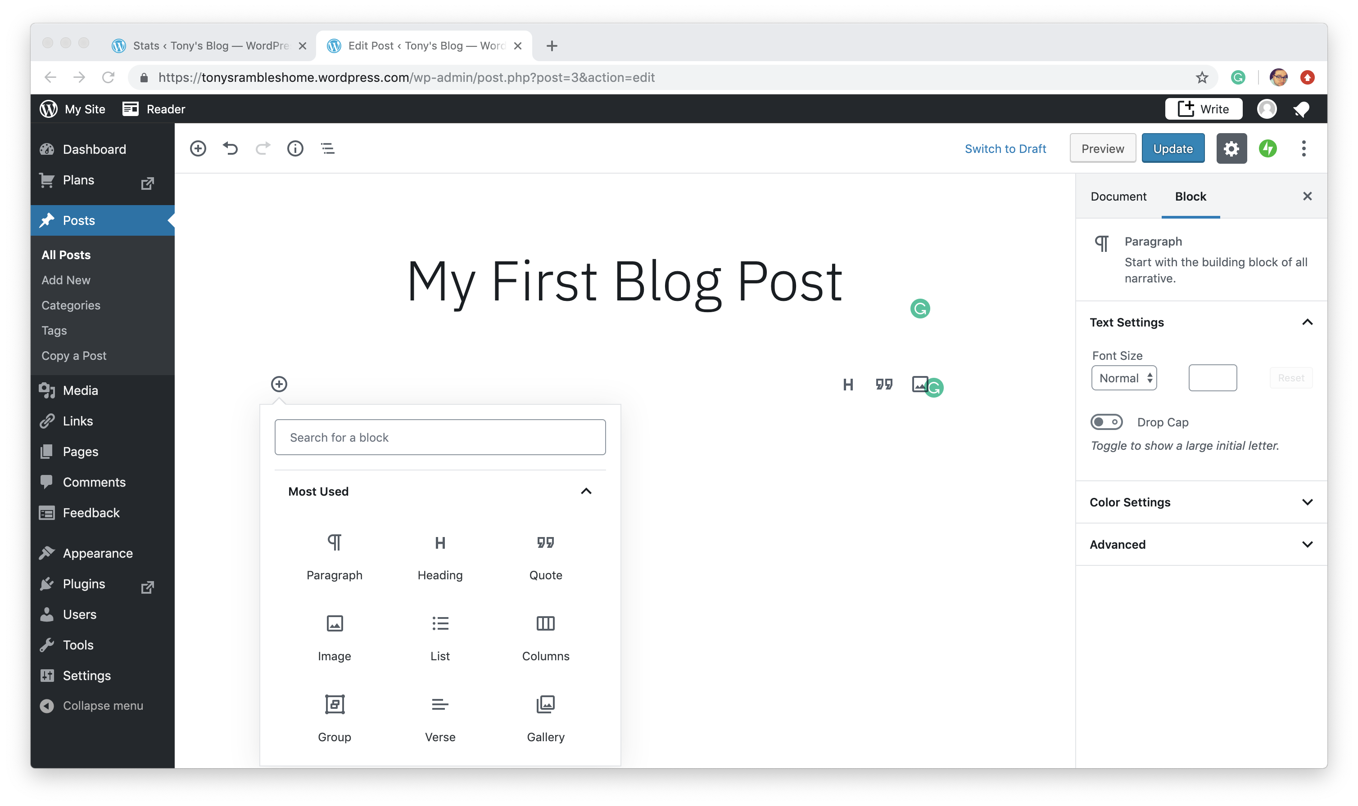
Blocks: Creating a post in the Wp-admin dashboard
Notes:
In order to be an effective story teller on Wordpress, you need to be able to provide more than just text in a post. This blogging project requires things like images and links, in addition to at least three paragraphs of quality text in each post. Don’t think of it like a diary, but a way to write about something you enjoy in a professional manner. Images and links really help out with that.
Copy text: “In order to effectively write with metaphors one needs to consider…”

